Slide 1

Stress Happens:
PTSD in Trauma Patients, Families and Care Providers
Michael L. Foreman, MD, FACS
Notes:
Why is a surgeon talking about ptsd. Not psych not ologist surgeon. We all know about surgeons.
Aging committee content expert internist. You are luck all you have to do is operate, you don’t have to think
So it is a little odd for a surgeon to be talking about ptsd. Doesn’t fit in with our conventional notions

Slide 2
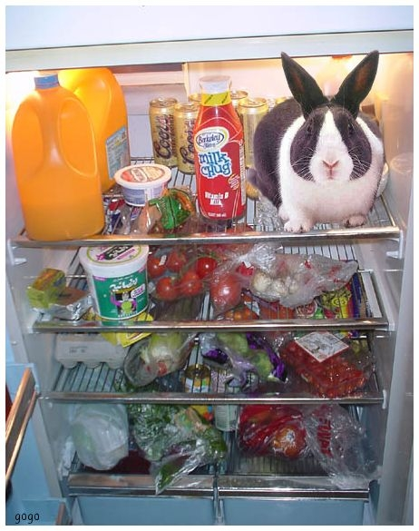
Notes:
I get that. Your saying why is he where is is and what is going on.
Here because of my ignorance. Couple of percent of pts with PTSD one or 2 a year no biggie. Until we studied and 25% were suffering and I didn’t see it.

Slide 3

Objectives
Define the characteristics of Posttraumatic Stress Disorder (PTSD)
Review populations at risk for developing PTSD
Discuss methods of recognizing PTSD and its complications
How to treat and/or prevent PTSD with the best possible outcomes
Notes:
how do different people have differing reactions to similar stimulus . why does an event cause differeing reactions in different people? How do we percieve and live inthe world

Slide 4

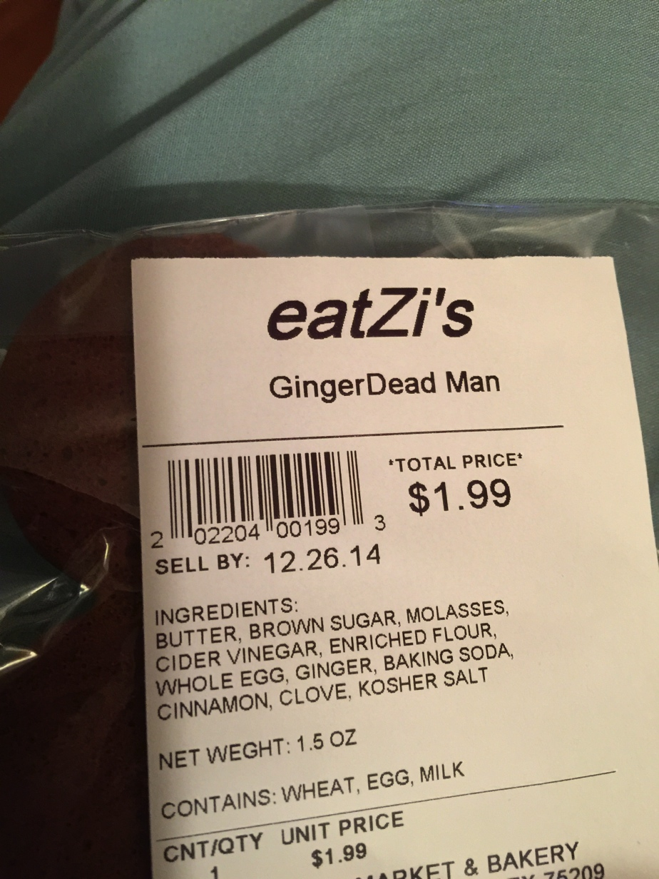
Use of “The Sixth Sense”
Notes:
----- Meeting Notes (3/26/15 07:30) -----
christmas looking at this tastey fellow. Look good to everyone ? What is it?? A gingerbread man. That is the stimulus we allmare geting however the new person funnung the label machine when presented with the same stimulus heard something else
----- Meeting Notes (3/26/15 07:54) -----
Looks the same tastes the same but different from same stimulus

Slide 5
Characteristics of PTSD

Slide 6
Posttraumatic Stress Disorder
DSM-5
Development of characteristic symptoms following exposure to one or more traumatic events.
Must meet diagnostic criteria from 5 clusters:
  A) Exposure to actual or threatened death, serious injury, or sexual violence in one (or more of the following ways):
    Directly experiencing the traumatic event, witnessing the event, learning that the event occurred to a close family member or friend, or repeated exposure to details of the event
  B) Intrusion
    Event is persistently re-experienced (e.g., flashbacks, nightmares, unwanted thoughts of the event)
  C) Avoidance
    Persistent, effortful avoidance of distressing trauma-related stimuli
  D) Negative Cognitions/Mood
    Alterations that began or worsened after event
  E) Alterations in Arousal and Reactivity
    Trauma-related alterations that began or worsened after trauma
Symptoms persist >1 month with significant distress and/or functional impairment
Notes:
----- Meeting Notes (3/25/15 23:25) -----
not trying to teach complex diagnosis here
----- Meeting Notes (3/26/15 07:54) -----
one from a and b. 2 from d and e. otherwise "unpecifed trauma related disorder"

Slide 7
Epidemiology of PTSD
U.S. National Comorbidity Survey Replication
  PTSD assessed among 5,692 participants (DSM-IV criteria)
  Lifetime prevalence 6.8%
  Female: Male ~2:1
Richardson et al (2010)
  4-17% of US veteran population
Warren et al (2014)
  ~25% of patients 6 months after traumatic injury
Warren et al (2013)
  ~22% of surgeons who care for trauma patients
Notes:
----- Meeting Notes (3/25/15 23:25) -----
civilian higher than military likely from noncondioning
----- Meeting Notes (3/26/15 07:54) -----
women more common in part because of incidence of sexual assault
My eyes were really opened with our results. I wold hve guessed a couple of percent

Slide 8
History of PTSD

Slide 9

“Shell Shock”
“Combat Exhaustion”
“Traumatic Neuroses”
Posttraumatic Stress Disorder
“Stress-Response Syndrome”
“Nostalgia”
“Railway Spine”
“Soldier’s Heart”

Slide 10
PTSD Throughout the Ages
While PTSD was only formally recognized and defined by the American Psychiatric Association in 1980, it was nothing new.
PTSD-esque conditions described using over 80 different names documented by various authors in varying parts of the world
Risk of exposure to traumatic events has been part of the human condition since the beginning of the species.

Slide 11

From fending off Saber-Toothed Tigers (and other prehistoric creatures)…
Notes:
----- Meeting Notes (3/25/15 23:25) -----
also get it from personal interaction

Slide 12

To the classics of literature…
Achilles
Henry IV:
“Tell me, sweet lord, what is't that takes from thee
Thy stomach, pleasure, and thy golden sleep?
Why dost thou bend thine eyes upon the earth,
And start so often when thou sit'st alone?
Why hast thou lost the fresh blood in thy cheeks,
And given my treasures and my rights of thee
To thick-eyed musing and cursed melancholy?”
Notes:
Act 1 scene 3 lady Percy to Lord Percy Hotspur
Herodotus, writing of the battle of Marathon in 490 BC, mentions an Athenian warrior who went blind when the soldier standing next to him was killed, although the blinded soldier “was wounded in no part of his body.”
----- Meeting Notes (3/25/15 23:25) -----
achilles contemplates his heel or stepped in something
Ajax

Slide 13
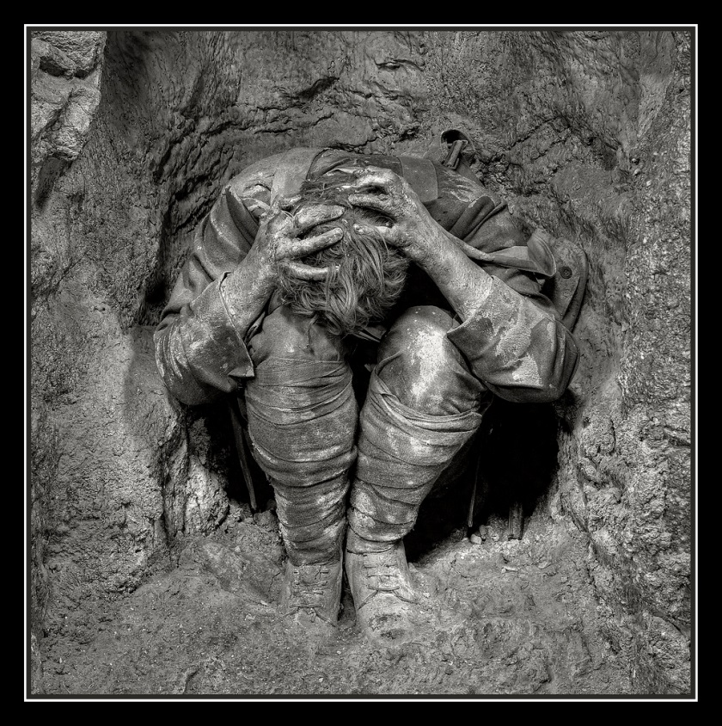
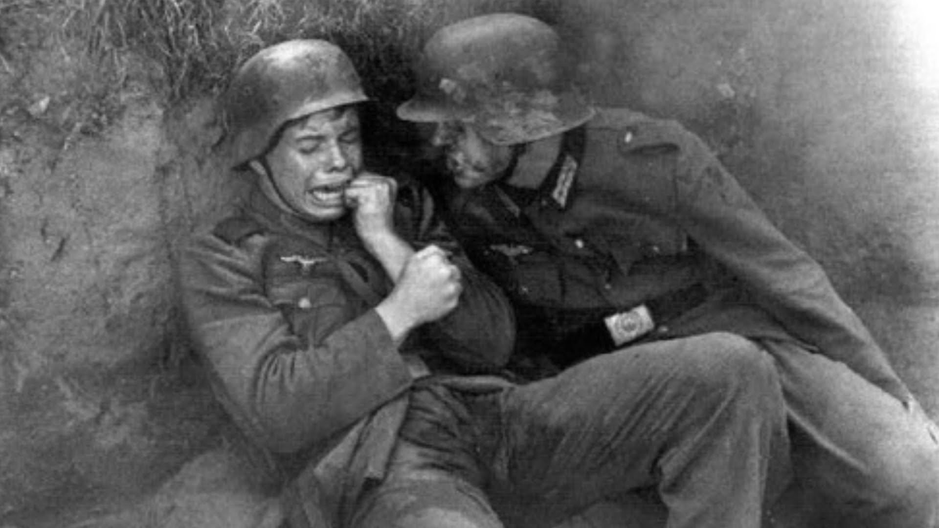
To “shell shock” in WWI
“Physical shock accompanied by horrifying circumstances, causing profound emotional shock and terror, which is contemplative fear, or fear continually revived by the imagination, has a much more intense and lasting effect on the mind than simple [physical] shock has.”
– Frederick Walker Mott, 1919
Notes:
----- Meeting Notes (3/26/15 07:54) -----
thought due to incessant artillery blast and the shock waves. interesting we now know that repeted concussive injury from explosion or football leads to a variety of psychological issues and are exploring minor tbi as a sensitizing injury fo developing ptsd

Slide 14
History of PTSD
When first described during WWI, was thought to be short-term condition that would resolve after being removed from combat
After Vietnam War, veterans diagnosed with “stress response syndrome”
  If lasted more than 6 months, VA declared that it was due to a pre-existing condition and treatment was no longer covered
    Addition to DSM-III in 1980 changed this
Was classified as an Anxiety Disorder until 2013
  Now part of new Trauma and Stressor-Related Disorders category
Notes:
Wonderful book Achilees in vietnam Dr John SHay

Slide 15
History of PTSD
Only relatively recently that awareness has grown about the presence of PTSD in non-military populations
Even more recent is inclusion of diagnostic criteria to account for those who are consistently exposed to aftermath of traumatic events
  Used to be called Secondary Traumatic Stress
  Now part of new Trauma and Stressor-Related Disorders category
Notes:
ebola workers

Slide 16
Physiology of PTSD
Why does it happen?
Notes:
----- Meeting Notes (3/25/15 23:25) -----
why does it happen

Slide 17
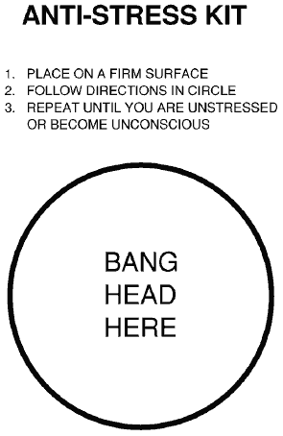
Estimated that 81% of Americans experience a trauma at some point in their lives
100% of people experience stress
  At what point does a stressor become traumatic?

Slide 18
A Quick Review
What happens during the human stress response?
Two aspects:
  Physiological
  Psychological

Slide 19
Physiology of Stress
When stressor occurs, amygdala triggers neural response in hypothalamus
Pituitary gland secretes ACTH, adrenal gland releases epinephrine
Release of chemicals results in production of cortisol
  Increased BP, blood sugar
Boost of energy, other fight or flight reactions

Slide 20
Psychology of Stress
Cognitive Appraisal
  The meanings we assign to the world around us
  E.g., That tiger running towards me is dangerous
Affective Integration
  Assigning emotions to the cognitive appraisal
  E.g., It’s dangerous, so I should be scared right now
The resulting cognitive-affective complex represents how stressors are perceived
  Decides if stimuli become stressors
  Related and interactive but independent
Notes:
Left brain right brain thing tiger running toward me but there is a big fence between us. Fear during bumpy flight

Slide 21
Psychology of Stress
Cognitive-affective process is individualized
  Depends on biological predispositions, personality, personal history, and coping style
What happens when there is a stimulus??
  One day, I was walking in the jungle…
Notes:
Historically you are going down the path in the jungle bopping along. There is a bush with red berries on it and you hear a funny sound. You walk around the bush

Slide 22

Feed Me
Notes:
----- Meeting Notes (3/25/15 23:37) -----
stimulus

Slide 23
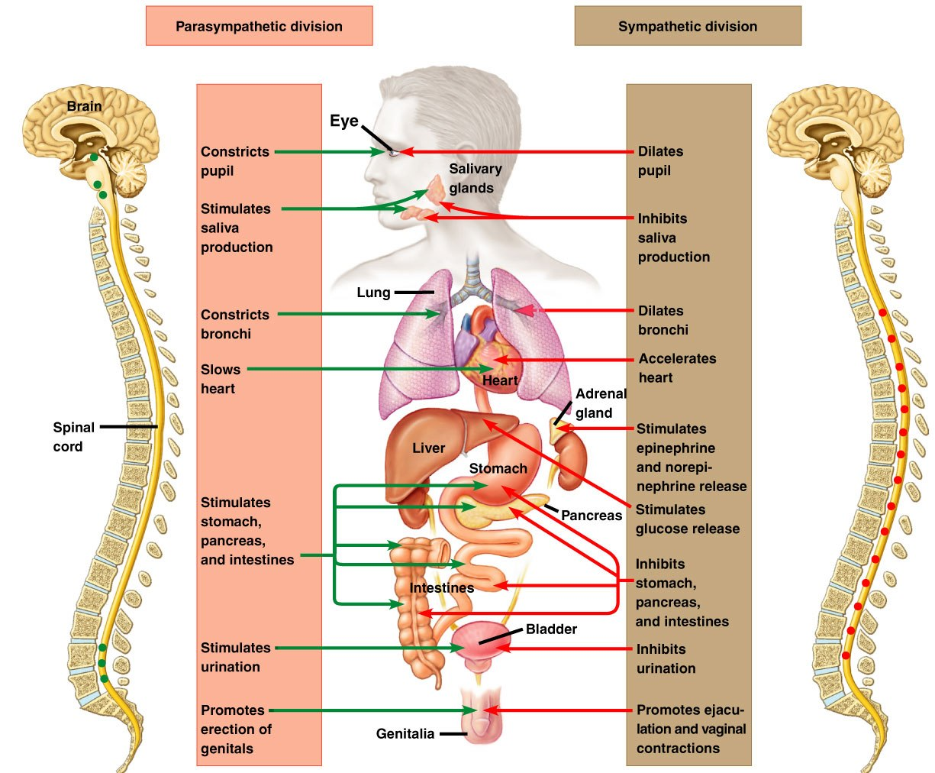
Notes:
Ombined firing of the sympathetic and some parasympatheteic amazing adaptive teliology.
Sympathetics cause the adrenals to dump catecholaminies. Liver dumps glycogen so you hve fuuel for the muscle and more importantly brain. Puils dialate to take in info.
Skin vasoconstricts a to shunt blood to important stuff and decrease blood loss. Cardiac output doubles and BP goes up. Fight or flight baby!
Parasympathetics break out in a sweat and yu evacuate bowel and bladder so you are already to keep the machinery cool and have minimized weight to make you faster. Plus your all sweaty so harger to hold on to and you peed and pood which might make you a little less tasty looking

Slide 24
Dessert Menu please
Notes:
Next time you are walking and see a bush with red berries and think you hear a funny noise?????
Bang im firing off my adrenal glands now before that monstr cat comes around the corner
Great survival skill. But what if the cat is

Slide 25

Feed me
Notes:
No longer adaptive.
But it is real and natural and a normal occurance.
ask audience how many have had a truely frightening event occur
Taco Bell experience story fast food kills. Hypervigalent replay over and over and over normal. Fades. But I learned. What if it doent fade?
----- Meeting Notes (3/25/15 23:37) -----

Slide 26
Neurobiology of PTSD
PTSD may be associated with stable neurobiological alterations in central and autonomic nervous systems
  Hyperarousal of sympathetic nervous system
  Increased sensitivity of blink reflex
  Sleep abnormalities

Slide 27
Neurobiology of PTSD
Neuropharmacological and neuroendocrine abnormalities detected in brain mechanisms involved in coping and adaptation
Structures thought to be involved in PTSD
  Amygdala, medial prefrontal cortex, hippocampus, anterior cingulate
Notes:
FMRI

Slide 28
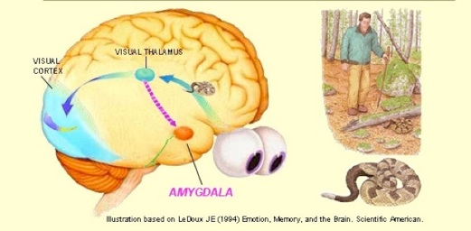
Amygdala
Assessment of threat-related stimuli
Formation and storage of memories associated with emotional events
Fear conditioning

Slide 29
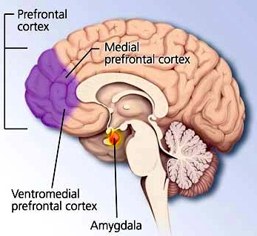
Medial Prefrontal Cortex
Involved in emotion regulation
Linked to extinction of fear conditioning

Slide 30
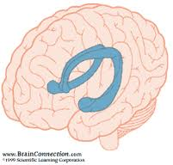
Hippocampus
Explicit memory
Encoding of context during fear conditioning
Interacts with amygdala during coding of emotional memories
Anterior Cingulate
Also involved in fear conditioning

Slide 31
Neurobiology of PTSD
Structural brain imaging shows reduced volume in hippocampus and anterior cingulate
Functional imaging suggests hyperactivity in in amygdala, reduced activation in prefrontal cortex and hippocampus
  Correlated with classic symptoms
    Hypervigilance
    Exaggerated startle response
    Triggers
    Memory issues surrounding the traumatic event

Slide 32
Risk Factors
Past studies show consistency in terms of some risk factors:
  Female gender
  Lower SES
  Premorbid psychological issues
  Previous trauma
Notes:
----- Meeting Notes (3/25/15 23:51) -----
Certainly genetics and perhaps biomics play a part

Slide 33
Other Issues to Consider
It’s not good for you

Slide 34
Links Between Psychological Stress and Physical Health
Increased health problems
  PTSD shown to be associated with poorer health outcomes
    Thought that neurochemical changes that occur create vulnerability to physical changes:
      Hypertension, athersclerosis
      Thyroid and hormone function
      Immunosuppression
      GI issues
      Musculoskeletal disorders
Notes:
----- Meeting Notes (3/25/15 23:51) -----
stress is not good for you

Slide 35
Links Between Psychological Stress and Physical Health
Research shows that psychological stress can increase wound healing time
  Longer length of stay
  Increased risk for infection, complications
  Level of distress shown to predict wound healing outcomes more than socio-demographic and medical variables
Possible that caregiver stress could be adding to this
  Research has shown that family members and friends of ICU patients have increased levels of depression and PTSD
  Could impact ability to provide proper care

Slide 36

Caregiver
Stress

Slide 37
Links Between Psychological Stress and Physical Health
Neglect of health behaviors
  Stress may cause adoption of unhealthy behaviors
    Alcohol and tobacco use
    Decreased physical activity
    Sleep disturbance
    Poor diet choices

Slide 38
Comorbidity
Depression
  Tend to report more somatic symptoms
  Use more medical treatment than non-depressed
  More likely to require rehospitalization for infection-related complications
  Linked to CV diseases, additional illness/mortality in pts w/ serious medical illness
Anxiety
  Linked to CV morbidity and mortality
Substance Use, smoking

Slide 39
Effect of Psychological Interventions
Behavioral stress management interventions before surgery associated with improved post-op outcomes
  Fewer complications and shorter hospital stay
Social support linked to better health outcomes

Slide 40
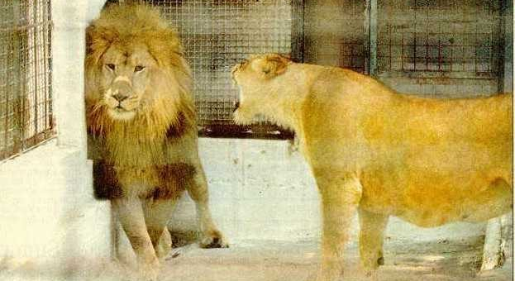
Behavioral modification
Trauma
Program
Manager
Trauma
Medical
Director

Slide 41
PTSD in the Trauma Center
Patients, Families, and Providers

Slide 42
PTSD in Trauma Patients
Predictors of PTSD in adults admitted to a level I trauma center: A prospective analysis. J Anxiety Disord. 2014; 28(3), 301-309.

Slide 43
“Predictors of PTSD Symptoms in Adults Admitted to Level I Trauma Center”
Participants
  N=327
  Patients admitted to Level I trauma center after injury
  64% male, 68% White, mean age of 46
  Hospital admission >24 hours
Measures
  PTSD Screening
  Demographic variables
  Psychological variables
  Hospitalization and injury characteristics
Notes:
BTOP

Slide 44
“Predictors of PTSD Symptoms in Adults Admitted to Level I Trauma Center”
Results
  Predictors of PTSD symptoms 3 months post-injury:
    Demographic Variables
      Younger age (p <.001)
    Psychological Variables
      Presence of depressive symptoms (p <.001)
      Premorbid psychiatric diagnoses (p=.003)

Slide 45
“Predictors of PTSD Symptoms in Adults Admitted to Level I Trauma Center”
Results cont.
  Predictors cont.
    Cause of Injury
      Penetrating injury (gunshot, stab wound) (p <.001)
      Pedestrian in auto vs. ped (p=.015)
    Injury-related Variables
      Greater pain 3 months after injury (p=.027)
      Higher pulse at admission (p=.002)
    Substance Use
      Higher rate of alcohol use (p=.031)

Slide 46
“Predictors of PTSD Symptoms in Adults Admitted to Level I Trauma Center”
Provides useful information for clinical care
Screening for PTSD symptoms in trauma patients may be helpful for early identification and intervention
  Identifying these patients and providing with treatment resources may improve physical and psychological outcomes and lead to cost savings for patient and hospital

Slide 47
PTSD in Family and Friends of ICU Patients
Warren, AM, Rainey, E., Reynolds, M., Weddle, R.J., Bennett, M.M., & Foreman, M.L. (2015). Predictors of PTSD and depression among family and friends of patients admitted to the ICU. Poster SCCM 2015

Slide 48
“Predictors of PTSD and Depression Among Family and Friends of Patients Admitted to the ICU”
Previous research has identified the development of adverse psychological outcomes, such as depression, post-traumatic stress, and complicated grief in individuals who have a loved one admitted to an intensive care unit (ICU)
Few studies have examined predictors of negative outcomes.

Slide 49
“Predictors of PTSD and Depression Among Family and Friends of Patients Admitted to the ICU”
Participants
  N=100
  Family and friends (> age 18) of patients admitted to trauma ICU for >48 hours
Measures
  Depression (Patient Health Questionnaire 8)
  PTSD symptoms (PC-PTSD)

Slide 50
“Predictors of PTSD and Depression Among Family and Friends of Patients Admitted to the ICU”
Results
  38% screened positive for depression
  24% screened positive for PTSD
  Low income and being parent of ICU patient were predictors of PTSD symptoms
  Female participants and those with premorbid psychological disorder had higher risk for depression

Slide 51
“Predictors of PTSD and Depression Among Family and Friends of Patients Admitted to the ICU”
Indicates that mental health of patients’ family and friends should be taken into consideration and addressed as part of global care in trauma centers
Could have impact on patients as well
  Caregiver role after patient discharge is an added stress
  If already struggling with depression or PTSD, symptoms may worsen, impact the level of care they can provide

Slide 52

Notes:
All depends on the setting. Here a local company. A poor name choice if you happen to be in Iran or afganistan

Slide 53
PTSD in Surgeons
Does caring for trauma patients lead to psychological stress in surgeons? J Trauma Acute Care Surg. 2013; 75(1): 179-184.

Slide 54
“Does Caring for Trauma Patients Lead to Psychological Stress in Surgeons?”
Another important issue to consider is the impact of exposure to trauma on health care providers
Referred to as Secondary Traumatic Stress prior to DSM-5
Originally described in mental health professionals
  Nurses
  ED physicians
  Social and child welfare workers
  Reported incidence from 16-78%

Slide 55
“Does Caring for Trauma Patients Lead to Psychological Stress in Surgeons?”
Factors generally involved in secondary traumatization:
  How intimately the provider is connected to the traumatic event experienced by the patient
  The provider’s perception of how extreme the event was
  The length of time provider was involved in the event.
Had not been studied in non-combat surgeons

Slide 56
“Does Caring for Trauma Patients Lead to Psychological Stress in Surgeons?”
Participants
  N=133
    Surgeons and residents in various specialties
    Surveyed at 2 regional surgical conferences
Measures
  Secondary Traumatic Stress Scale (STSS)*
    Measure of PTSD symptoms
    Conducted prior to DSM-5*
  Connor Davidson Resilience Scale (CD-RISC)
    Measure of resilience levels
  Amount of time spent caring for trauma patients

Slide 57
“Does Caring for Trauma Patients Lead to Psychological Stress in Surgeons?”
Resilience
An individual’s personal qualities and skills that enable them to flourish in the face of adversity or a disruptive event (Bonanno, 2004)
“The process of adapting well in the face of adversity, trauma, tragedy, threats or significant sources of stress”

Slide 58
“Does Caring for Trauma Patients Lead to Psychological Stress in Surgeons?”
21% of responding surgeons met diagnostic criteria for STS/PTSD
No correlation to the amount of exposure to trauma patients or years in practice to symptoms of STS/PTSD
Resilience correlated inversely with degree of STS/PTSD symptoms generally
For respondents meeting criteria for STS/PTSD resilience scores were significantly lower

Slide 59
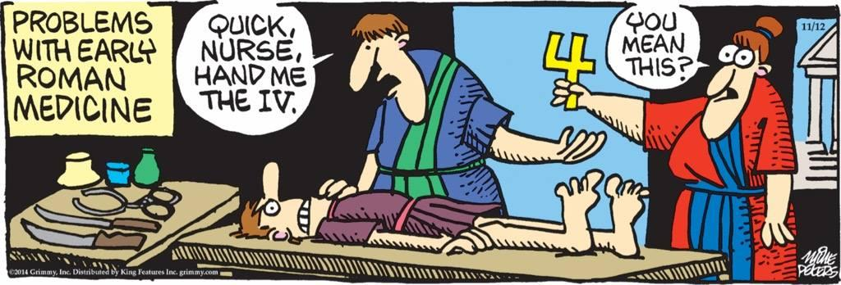
IMG_0428

Slide 60
Stress in Healthcare Providers
. (2010). Professional burnout, vicarious trauma, secondary traumatic stress, and compassion fatigue: A review of theoretical terms, risk factors, and preventive methods for clinicians and researchers. Best Practices in Mental Health: An International Journal, 6(2), 57-68.

Slide 61
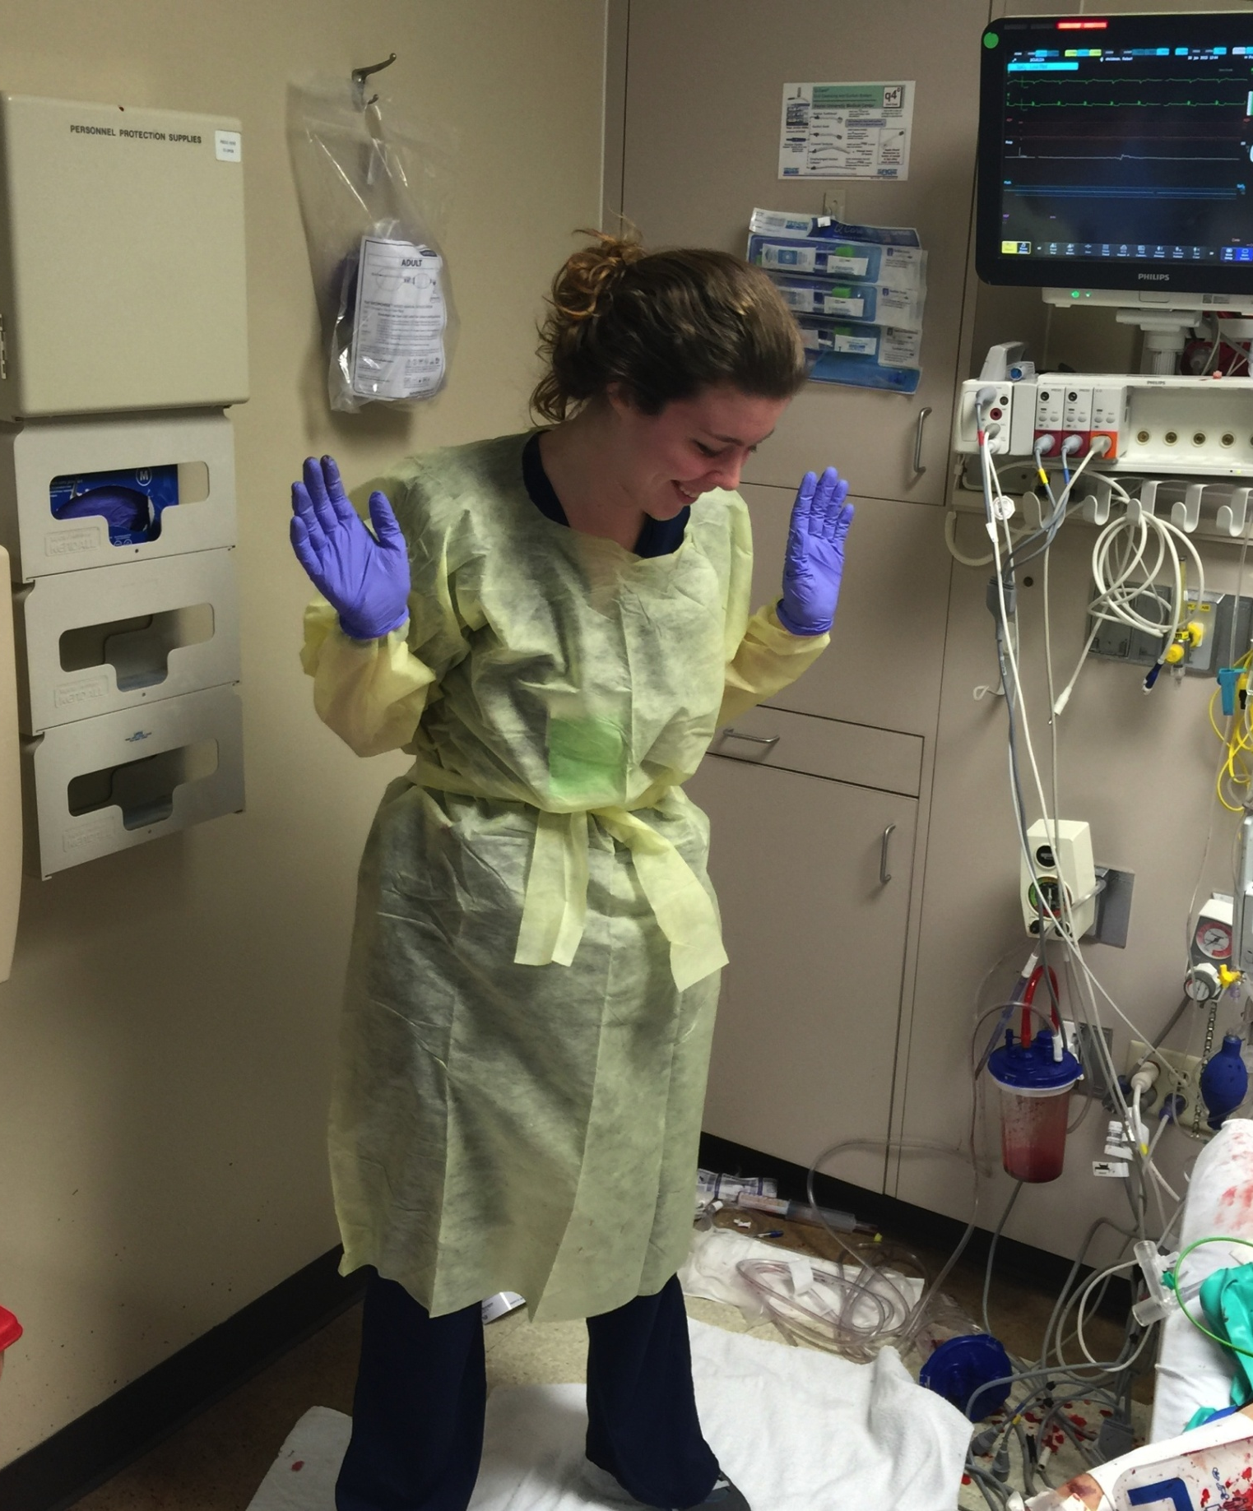
Another
Easy
Day at
Work

Slide 62
Burnout vs. Traumatic Stress
Burnout
  Relates to long-term exhaustion and diminished interest in work
  Progressive state occurring cumulatively over time
    Related to the individual, the populations served, and the organization worked for
  Symptoms similar to depression
    Physical and emotional exhaustion
    Cynicism and detachment
    Feelings of ineffectiveness and lack of accomplishment

Slide 63
Traumatic Stress
Associated specifically with working with trauma populations
  “Natural and consequential behaviors and emotions resulting from knowing about a traumatizing event experienced by a significant other [or patient] and the stress resulting from helping or wanting to help a traumatized or suffering person”

Slide 64
Traumatic Stress in Providers
Any range of PTSD symptoms may be present, even if do not meet full criteria for PTSD diagnosis
Most common are intrusive thoughts, memories or nightmares about patient trauma, trouble sleeping, irritability or angry outbursts, difficulty concentrating, avoidance of patients
Notes:
----- Meeting Notes (3/26/15 09:10) -----
wont ask for a show of hands but how many in this room have had or continue to have these?

Slide 65
Traumatic Stress in Providers
Who is most at risk?
  Pre-existing psychological diagnoses (e.g., depression, anxiety, personal trauma history)
  Low levels of resilience
  Poor coping skills
Notes:
----- Meeting Notes (3/26/15 09:10) -----
like torture enough and all break

Slide 66
How to Help
For either burnout or traumatic stress, need to be aware of how it is impacting personal and professional domains
Professional self-care
  Efforts to maintain personal, familial, emotional, and spiritual needs while still meeting professional demands
  Awareness of own stress levels and having strategies to manage it
    Taking breaks
    Adequate rest (when possible)
    Maintaining social support connections
    Efforts to increase resilience
Notes:
----- Meeting Notes (3/26/15 09:10) -----
hand washing ritual
lavender

Slide 67
How to Help
At the organizational level
  Social support from professional colleagues
    Concrete support (assisting with work load)
    Emotional support
      Comfort
      Insight
      Advice
      Humor
  Lets colleagues know they are not alone in the issues they are experiencing
Notes:
Our profession is really centered around suffering. We each try to deal with the suffering of others a part of our day to day professional work. In order to interact with suffering and try to assist, we must first make sure we have addressed and recognized our own suffering. That is the lens through which we take in others and the tool that shapes our response.
It is similar to the old saying of the first thing to do in a code is check your own pulse.
I know we have a mix of specialties in the audience prehospital and inpatient. For my money though it’s the bedside nurse who likely is most vulnerable. Paramedics go to the war zone swoop in, carry out drop off and go back for more. I get to come in do my thing and leave. The nurse is there all day long. Back the next and the next. The intimacy of interaction that is nursing exposes you longer and more intensly than anyone else. Hats off to you.

Slide 68

The ongoing tragedy of typewriting while driving

Slide 69
Treatment of PTSD

Slide 70
What do you do if you suspect PTSD in a patient, family member, or provider (yourself or someone else)?
Screens may be particularly effective in medical setting
  Quick (as few as 4 questions), empirically validated
  Easy to administer
Have resources available for patients and family members
  Intervention while in the hospital, or providing with referrals for after discharge

Slide 71
Primary Care PTSD Screen
PC-PTSD
In your life have you had and experience that was so frightening, horrible or upsetting that in the past month you:
  Had nightmares about it or thought about it when you didn't’t want to?
  Tried hard not to think about it or went out of your way to avoid situations that reminded you?
  Were constantly on guard, watchful or easily startled?
  Felt numb or detached from others, activities, or your surroundings?
3 yes answers = positive screen for PTSD

Slide 72
Treatment
Numerous ways that PTSD can be treated
Highly effective in most cases
Therapy
  Cognitive Behavioral Therapy (CBT) has been shown to be most effective type of counseling for PTSD
  Group therapy
Medications
  SSRIs have been FDA approved for the treatment of PTSD
Notes:
----- Meeting Notes (3/26/15 09:10) -----
avoid benzos

Slide 73
Conclusions
PTSD is a relevant concern in the trauma setting
  Present in patients, family members, and providers
May have impacts on health outcomes for patients, level of care or involvement in families/friends, and patient care and work productivity in providers
Predictive factors may be used to identify those most at risk for developing symptoms; screens available for assessing
Providing interventions or resources for patients and families should be a priority
Self-care and awareness of burnout and stress in providers should be encouraged

Slide 74

Kenleigh Roden-Foreman
Co-author

Slide 75

Questions?

Slide 76
References
American Psychological Association. The road to resilience. http://www.apa.org/helpcenter/road-resilience.aspx
Balch, C. M., & Shanafelt, T. (2011). Combating stress and burnout in surgical practice: a review. Thoracic surgery clinics, 21(3), 417-430.
Brewin, C. R., Andrews, B., & Valentine, J. D. (2000). Meta-analysis of risk factors for posttraumatic stress disorder in trauma-exposed adults. Journal of consulting and clinical psychology, 68(5), 748.
Friedman, M.J., Charney, D.S. & Deutch, A.Y. (1995) Neurobiological and clinical consequences of stress: From normal adaptation to PTSD. Philadelphia: Lippincott-Raven.
Friedman, M.J. (2014). PTSD history and overview. http://www.ptsd.va.gov/professional/PTSD-overview/ptsd-overview.asp
Gouin, J.-P., & Kiecolt-Glaser, J. K. (2011). The Impact of Psychological Stress on Wound Healing: Methods and Mechanisms. Immunology and Allergy Clinics of North America, 31(1), 81–93.
Jankowski, K. (2014). PTSD and physical health. http://www.ptsd.va.gov/professional/co-occurring/ptsd-physical-health.asp
National Center for PTSD. (2014). Treatment of PTSD. http://www.ptsd.va.gov/public/treatment/therapy-med/treatment-ptsd.asp
Newell, J.M. & MacNeil, G.A. (2010). Professional burnout, vicarious trauma, secondary traumatic stress, and compassion fatigue: A review of theoretical terms, risk factors, and preventive methods for clinicians and researchers. Best Practices in Mental Health: An International Journal, 6(2), 57-68.

Slide 77
Powers, M., Warren, A.M, Rosenfield, D., Roden-Foreman, K., Bennett, M., Self, M.,Foreman, M., Petrey, L, & Smits, J. Predictors of PTSD in adults admitted to a level I trauma center: A prospective analysis. J Anxiety Disord. 2014; 28(3), 301-309.
Scheier, M. F., Matthews, K. A., Owens, J. F., Schulz, R., Bridges, M. W., Magovern, G. J., & Carver, C. S. (1999). Optimism and rehospitalization after coronary artery bypass graft surgery. Archives of internal medicine, 159(8), 829-835.
Sherin, J. E., & Nemeroff, C. B. (2011). Post-traumatic stress disorder: the neurobiological impact of psychological trauma. Dialogues in Clinical Neuroscience, 13(3), 263–278.
Sherrer, M. V. (2011). The role of cognitive appraisal in adaptation to traumatic stress in adults with serious mental illness: A critical review. Trauma, Violence, & Abuse, 12(3), 151-167.
Shiromani, P. J., Keane, T. M., & LeDoux, J. E. (Eds.). (2009). Post-Traumatic Stress Disorder: Basic science and clinical practice. New York: Humana Press.
Walburn J, Vedhara K, Hankins M, Rixon L, Weinman J.(2009) Psychological stress and wound healing in humans: a systematic review and meta-analysis. J Psychosom Res.; 67(3):253-71.
Warren AM, Jones, AL, Shafi S, Roden-Foreman K, Bennett M, Foreman, ML. Does caring for trauma patients lead to psychological stress in surgeons? J Trauma Acute Care Surg. 2013; 75(1): 179-184.
Warren, AM, Rainey, E., Reynolds, M., Weddle, R.J., Bennett, M.M., & Foreman, M.L. (2015). Predictors of PTSD and depression among family and friends of patients admitted to the ICU. Poster SCCM 2015

Slide 78
This is only a test. would be called to it. and your attention would be displayed useful or meaningful information
In the event of a real slide,
This is only a test
Please do not read this slide.

